Slide 1
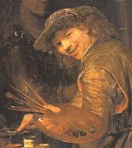

Arent de Gelder
1645 – 1727 和

Slide 2
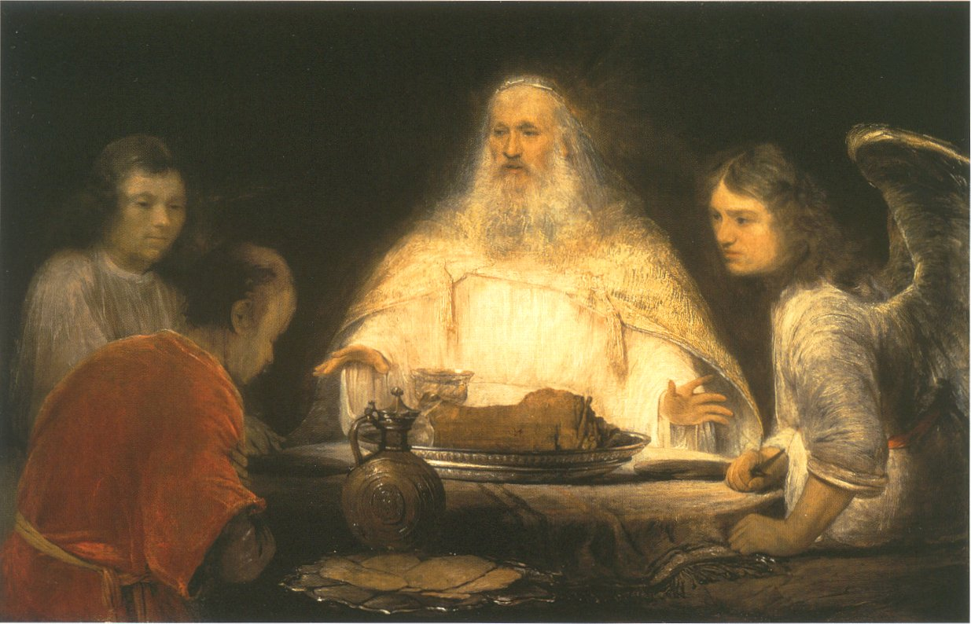
God and the Angels visit Abraham 창18:10
Notes:
God and the Angels visit Abraham
oil on canvas (111 × 174 cm) — c. 1680 - 1685 Museum Boijmans Van Beuningen, Rotterdam
Arent de Gelder biography
This work is linked to Genesis 18:10

Slide 3
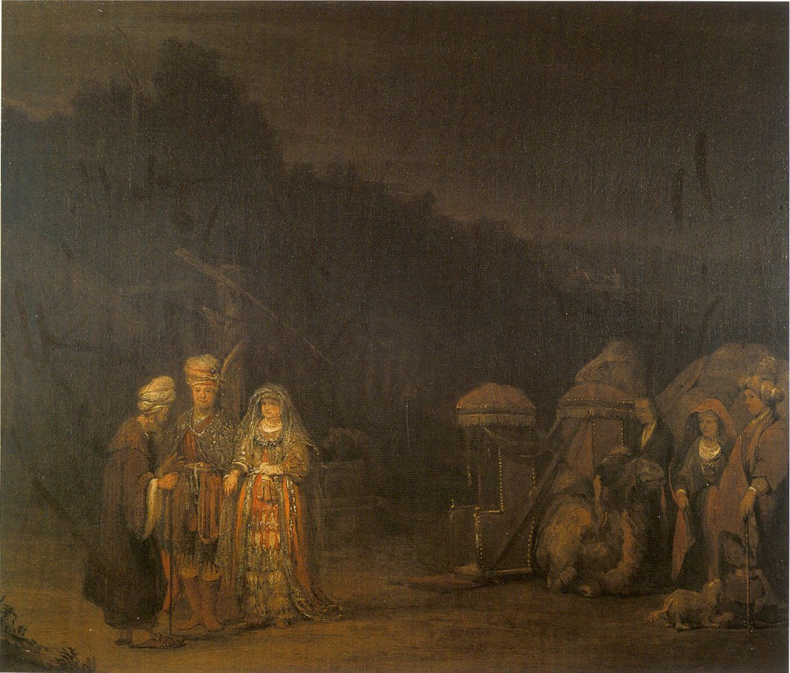
Isaac meets Rebekah 창24:66
Notes:
Isaac meets Rebekah
oil on canvas (59 × 69 cm) — c. 1665 Museum of the City of Brussels - Maison du Roi, Brussels
Arent de Gelder biography
This work is linked to Genesis 24:66

Slide 4
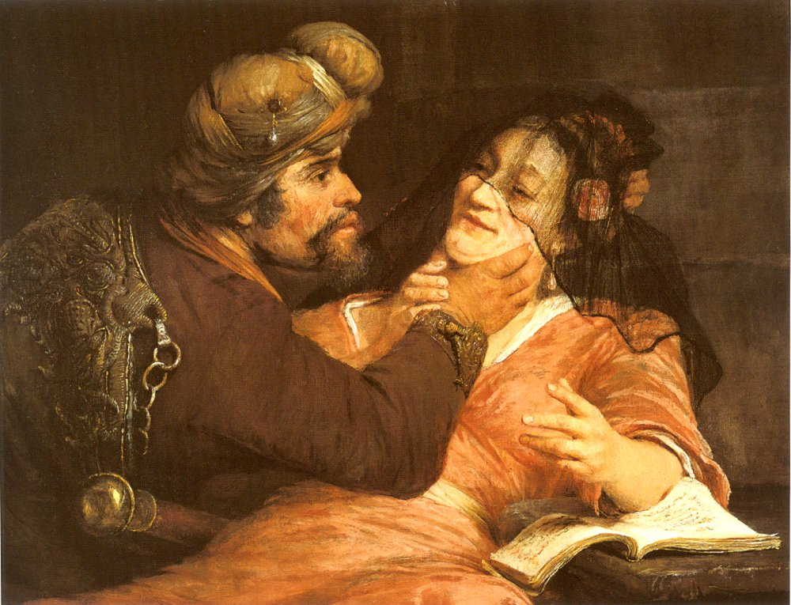
Judah and Tamar 창38:16
Notes:
Judah and Tamar (1667)
oil on canvas (64 × 88 cm) — 1667
private collection
Arent de Gelder biography
This work is linked to Genesis 38:16

Slide 5
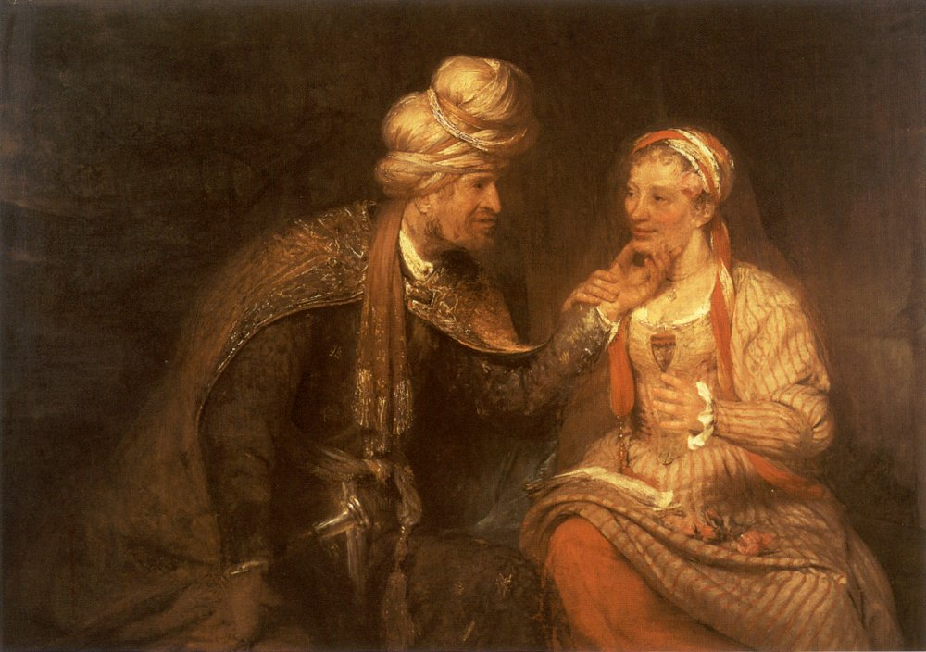
Judah and Tamar 창38:16
Notes:
Judah and Tamar (1681)
oil on canvas (102 × 147 cm) — 1681
private collection
Arent de Gelder biography
This work is linked to Genesis 38:16

Slide 6
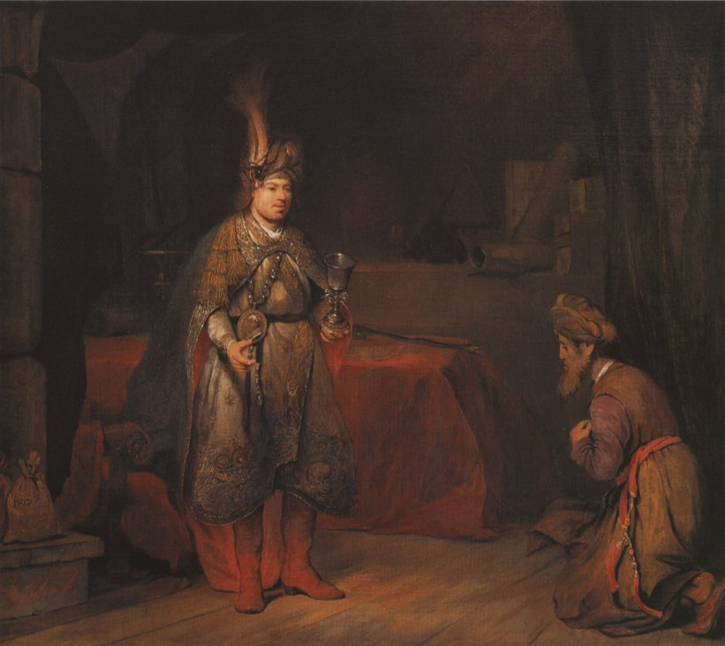
Judah and Joseph 창44:18
Notes:
Judah and Joseph
oil on canvas (99 × 113 cm) — ca. 1680-1685
private collection
Arent de Gelder biography
This work is linked to Genesis 44:18

Slide 7
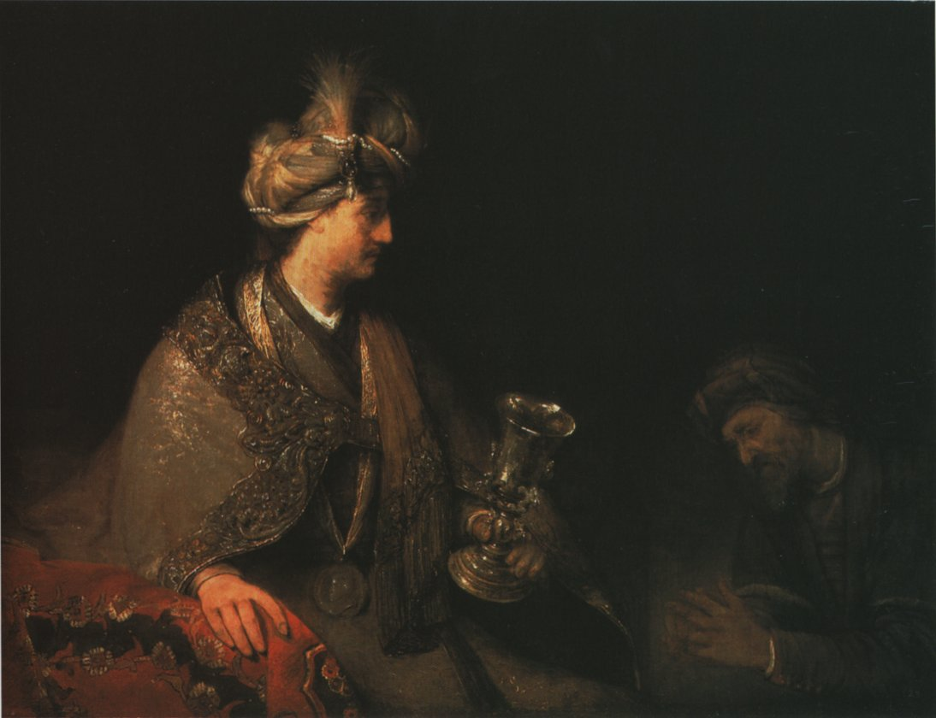
Joseph and Judah with the Cup 창44:18
Notes:
Joseph and Judah with the Cup
oil on canvas (115 × 150 cm) — c. 1682 Palatinate Museum, Heidelberg
Arent de Gelder biography
This work is linked to Genesis 44:18

Slide 8
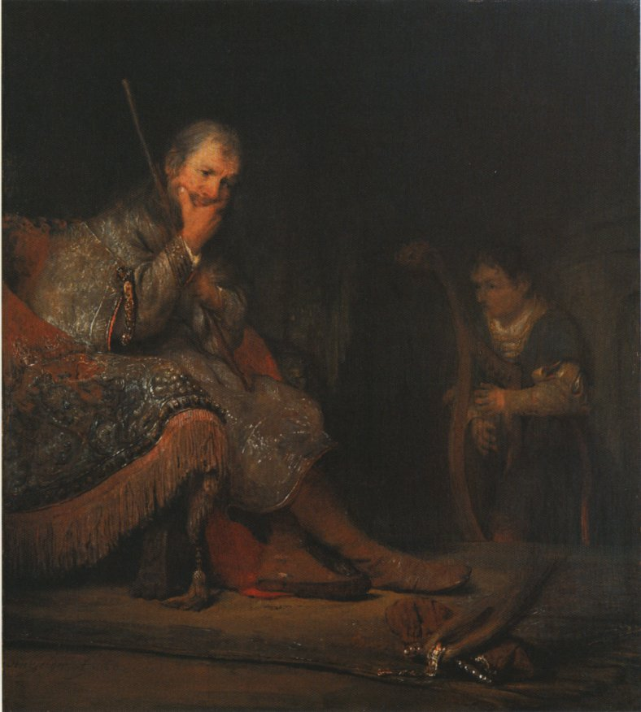
David Plays for Saul 삼상18:10
Notes:
David Plays for Saul
oil on canvas (66 × 59 cm) — 1682 Kunsthalle, Bremen
Arent de Gelder biography
This work is linked to 1 Samuel 18:10

Slide 9
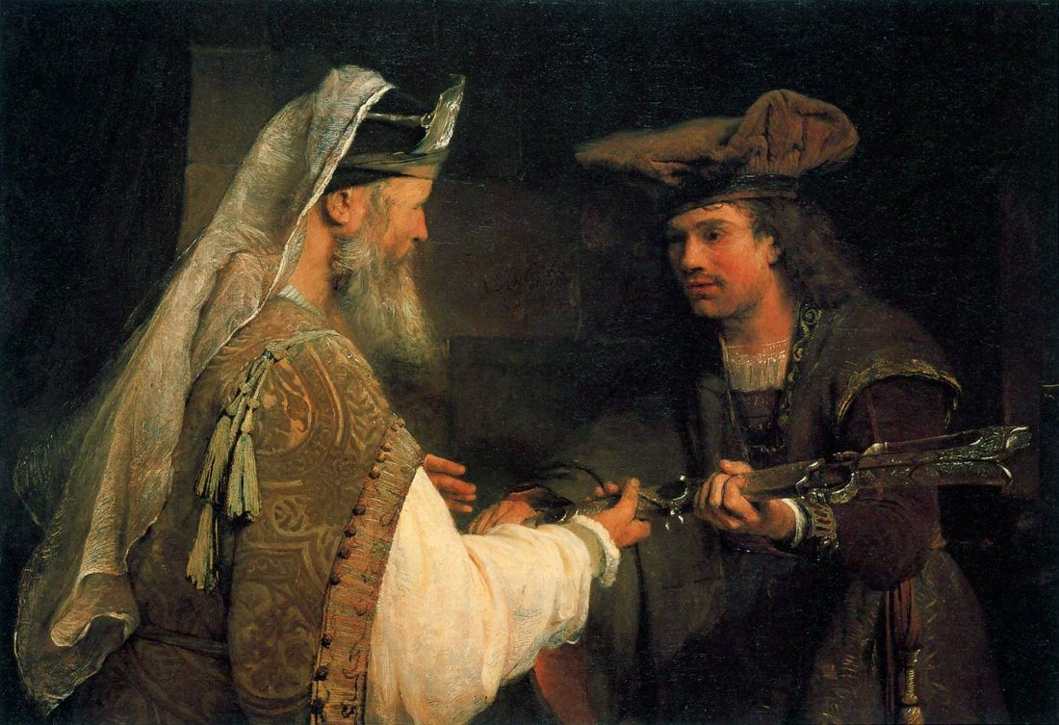
Ahimelech giving Goliath's sword to David 삼상21:9
Notes:
Ahimelech giving Goliath's sword to David
oil on canvas (90 × 132 cm) — c. 1680 J. Paul Getty Museum, Los Angeles
Arent de Gelder biography
This work is linked to 1 Samuel 21:9

Slide 10
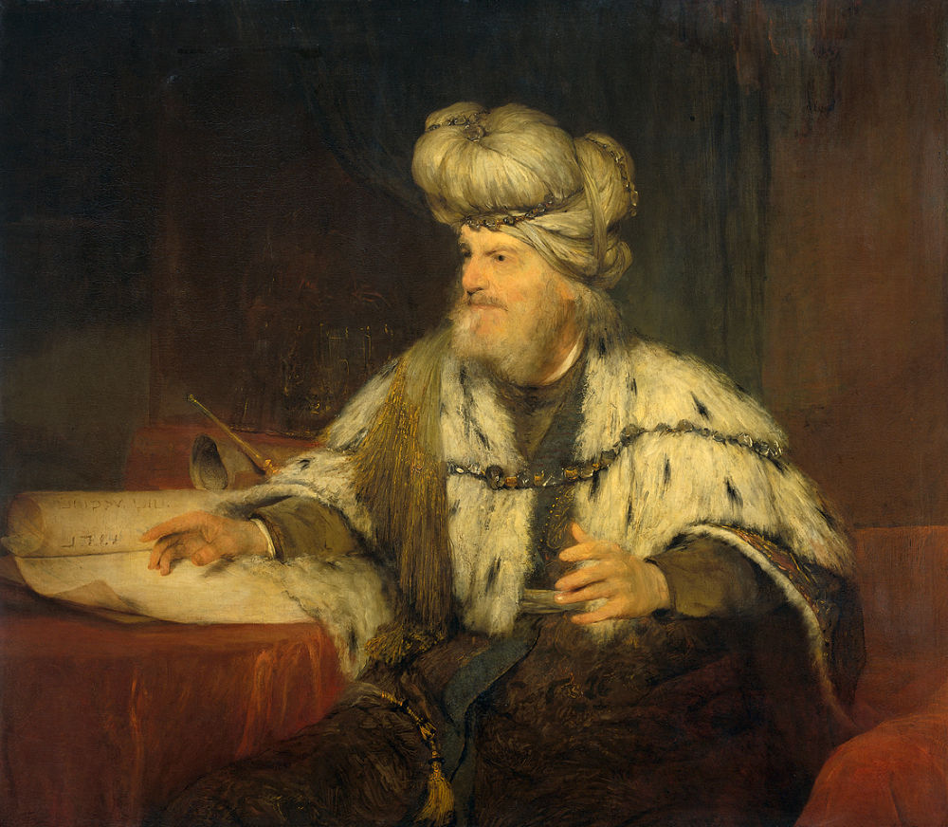
King David 삼상23:1
Notes:
King David
oil on canvas (109 × 114 cm) — 1680-85 Rijksmuseum, Amsterdam
Arent de Gelder biography
This work is linked to 2 Samuel 23:1

Slide 11
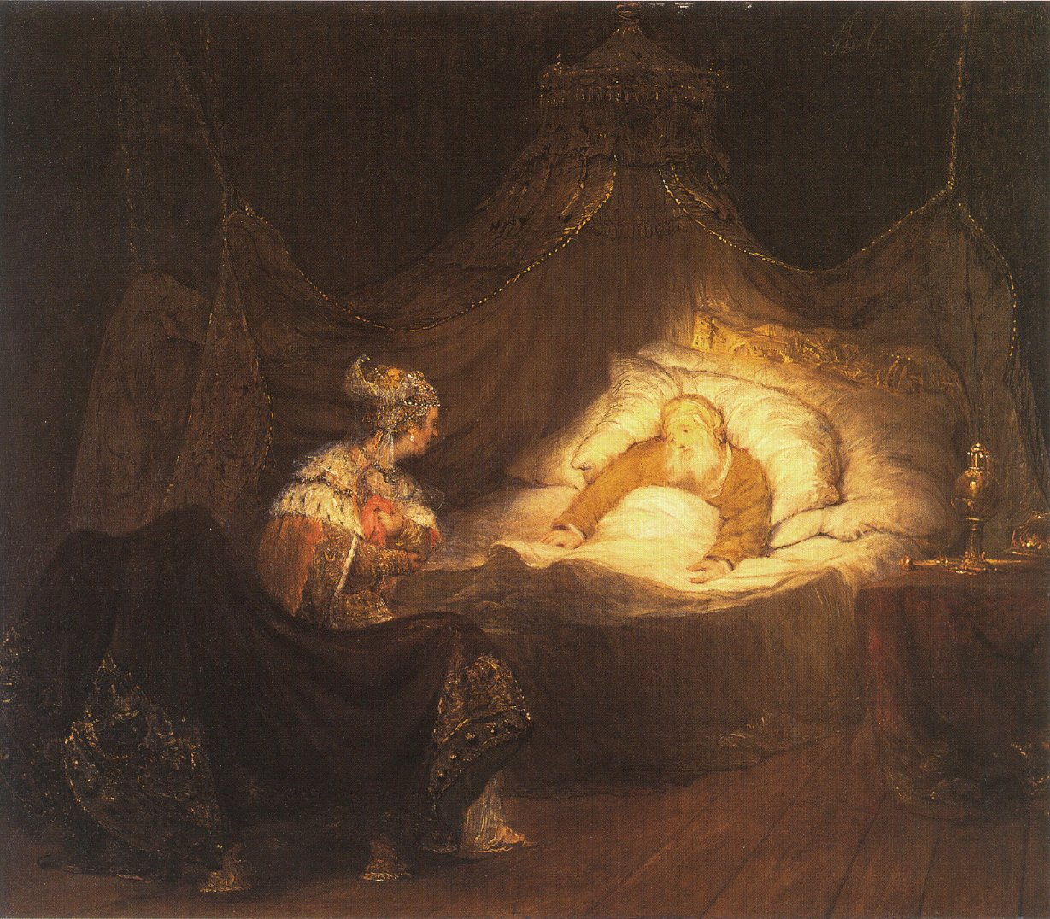
Bathsheba makes an appeal to David 왕상1:16
Notes:
Bathsheba makes an appeal to David
oil on canvas (86 × 100 cm) — c. 1685 - 1690
private collection
Arent de Gelder biography
This work is linked to 1 Kings 1:16

Slide 12
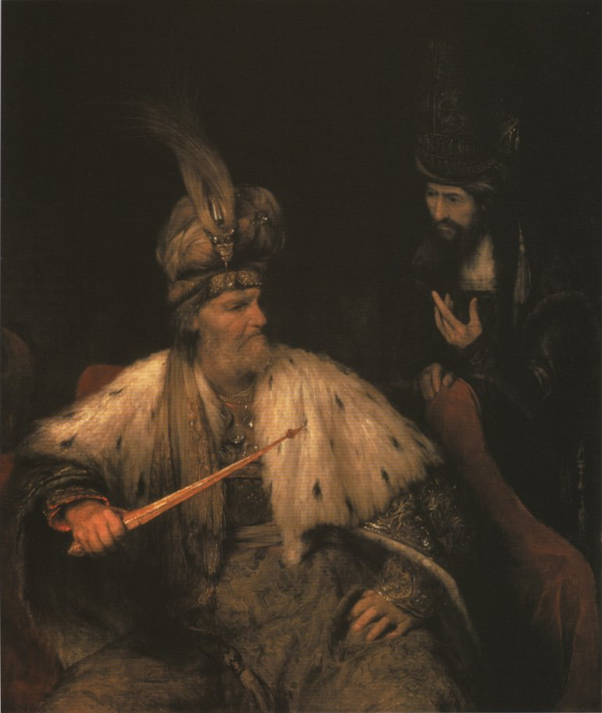
Ahasuerus and Haman 더3:9
Notes:
Ahasuerus and Haman
oil on canvas (138 × 117 cm) — c. 1682 Barber Institute of Fine Arts, Birmingham (UK)
Arent de Gelder biography
This work is linked to Esther 3:9

Slide 13
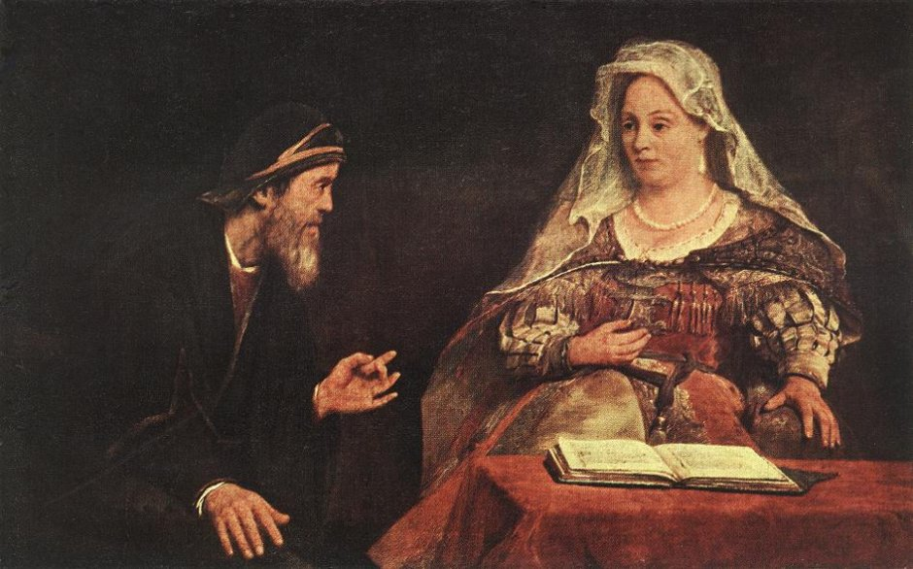
Esther and Mordecai 더4:13
Notes:
Esther and Mordecai
oil on canvas (93 × 148 cm) — 1685 Museum of Fine Arts, Budapest
Arent de Gelder biography
This work is linked to Esther 4:13

Slide 14
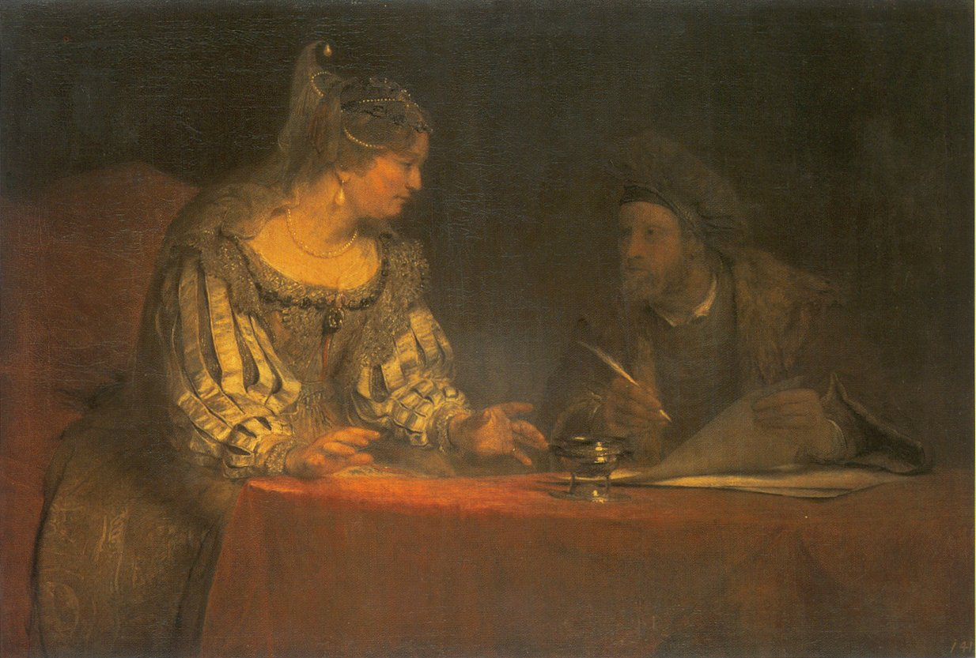
Esther and Mordecai writing the first letter of Purim 더9:20
Notes:
Esther and Mordecai writing the first letter of Purim
oil on canvas (102 × 152 cm) — c. 1685 Gem�ldegalerie Alte Meister, Dresden
Arent de Gelder biography
This work is linked to Esther 9:20

Slide 15
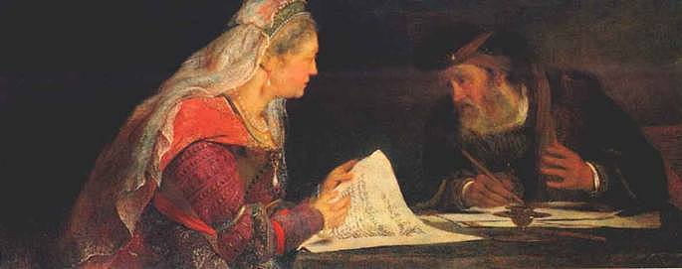
Esther and Mordecai Writing the Second Letter of Purim 더9:29
Notes:
Esther and Mordecai Writing the Second Letter of Purim
oil on canvas (59 × 143 cm) — ca. 1685 RISD Museum of Art, Providence RI
Arent de Gelder biography
This work is linked to Esther 9:29

Slide 16
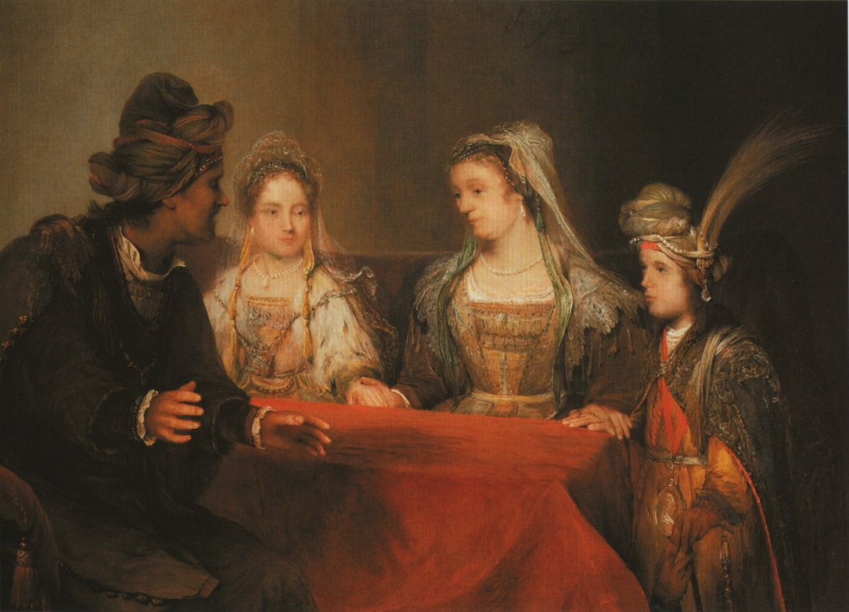
Tobias in the House of Edna and Raguel 토빗7:13
Notes:
Tobias in the House of Edna and Raguel
oil on canvas (113 × 154 cm) — c. 1690
private collection
Arent de Gelder biography
This work is linked to Tobit 7:13

Slide 17
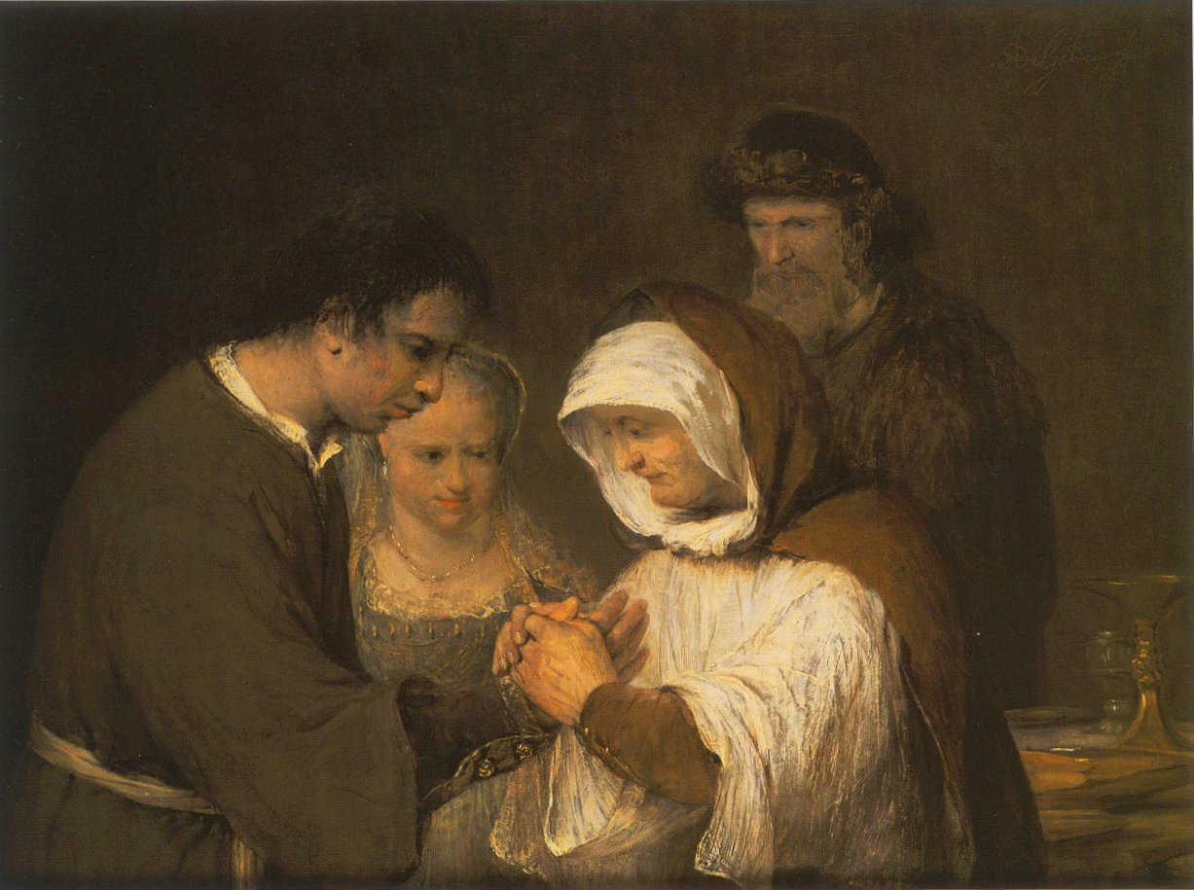
Edna blesses Tobias and Sara 토빗10:12
Notes:
Edna blesses Tobias and Sara
oil on canvas (88 × 112 cm) — c. 1705-1710 Museum Catharijneconvent, Utrecht
Arent de Gelder biography
This work is linked to Tobit 10:12

Slide 18
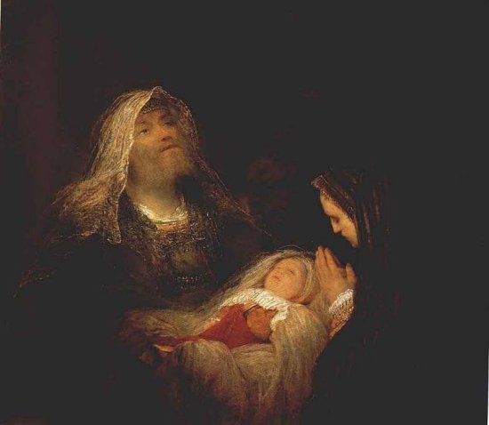
Simeon and Anna Praise the infant Jesus 눅2:25
Notes:
Simeon and Anna Praise the infant Jesus
oil on canvas (94 × 107 cm) — c. 1700 Mauritshuis, The Hague
Arent de Gelder biography
This work is linked to Luke 2:25

Slide 19
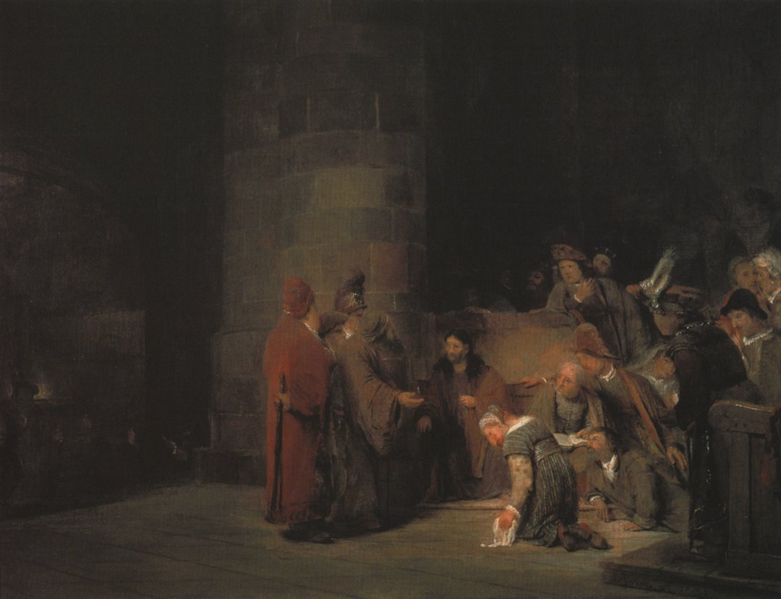
Christ and the Adulteres 요8:3
Notes:
Christ and the Adulteress
oil on canvas (72 × 94 cm) — 1683 Museo Thyssen-Bornemisza, Madrid
Arent de Gelder biography
This work is linked to John 8:3

Slide 20
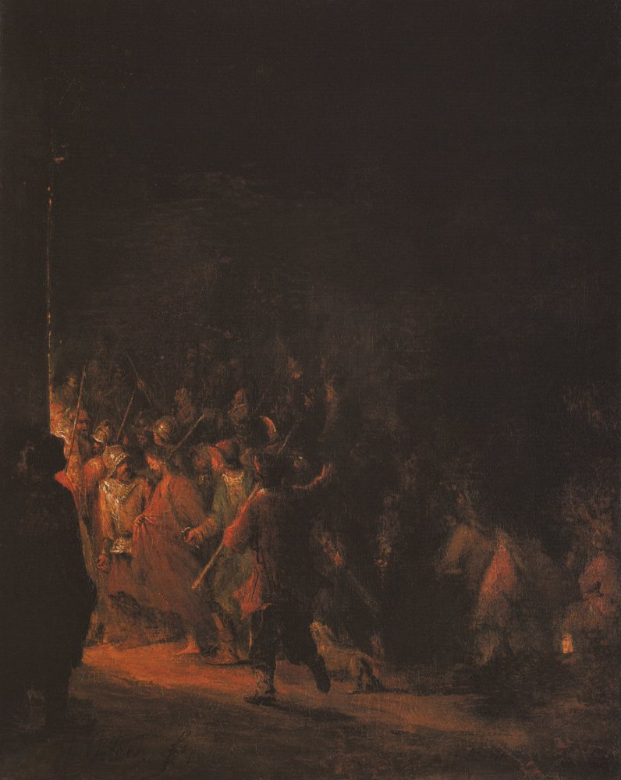
Jesus Taken to the House of the High Priest 요18:13
Notes:
Jesus Taken to the House of the High Priest
oil on canvas (73 × 59 cm) — c. 1715 Rijksmuseum, Amsterdam
Arent de Gelder biography
This work is linked to John 18:13

Slide 21
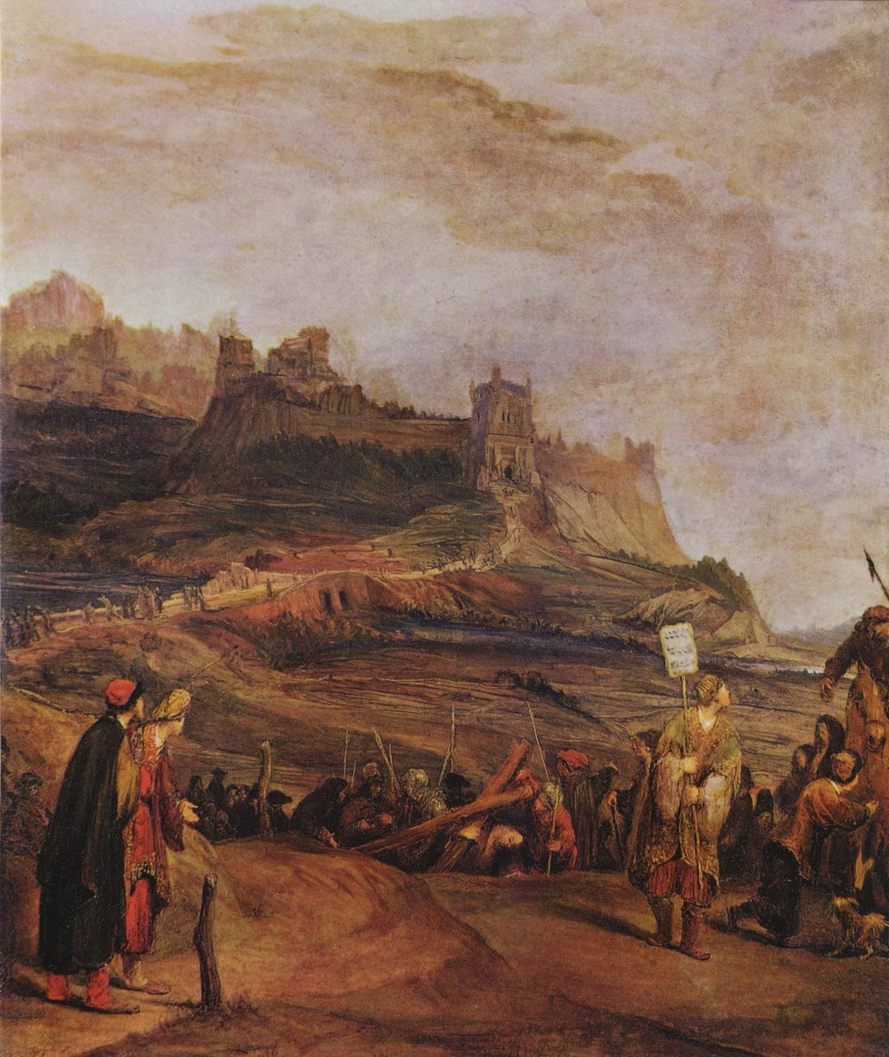
Journey to Golgotha 요19:17
Notes:
Journey to Golgotha
oil on canvas (72 × 60 cm) — 1715 Staatsgalerie, Aschaffenburg
Arent de Gelder biography
This work is linked to John 19:17

